Slide 1

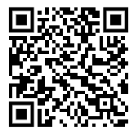

Real-Time Heat Risk Assessment – Uses local weather data and user inputs to calculate heat stress risk. Outdoors and Indoors!
Wet-Bulb Globe Temperature (WBGT) Index – Provides a gold-standard evaluation of heat stress.
Customizable Inputs – Users can select workload intensity, clothing type, cloud coverage, and more.
Heat Alerts & Health Recommendations – Offers guidance on rest breaks, hydration, and risk levels.
Multilingual Support – Available in English, Spanish, French, and Portuguese.
Free & Easy to Use – Accessible on both iOS and Android platforms.
American Industrial Hygiene Association (AIHA)
Heat Stress Mobile App
App Store Download QR Code

Slide 2
